Slide 1
PnP Community Call – September 2014
aka.ms/OfficeDevPnP
aka.ms/OfficeDevPnPYammer
Vesa Juvonen
Senior Program Manager
Microsoft

Slide 2




Agenda
Introduction
Contributions and process
Other topics
Roadmap and next steps

Slide 3
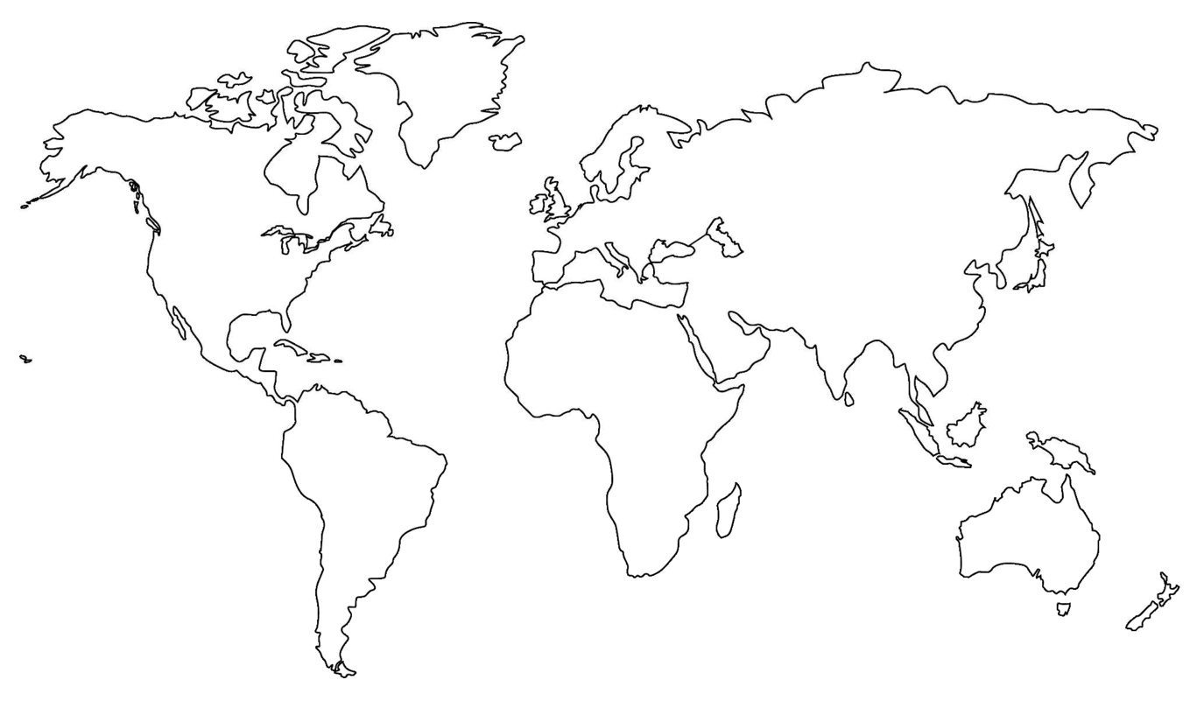

Where are you located?
Stamp Tool
Notes:
Length: 2 minutes for this slide
This slide is a quick demo/practice of the “Stamp” tool and how to use it during course interactions.
Have students Check where they live.
If it’s a small class, have students type their name where they live.
Reach out to the farthest away student

Slide 4


Developer
Patterns & Practices
aka.ms/OfficeDevPnP
aka.ms/OfficeDevPnPYammer

Slide 5

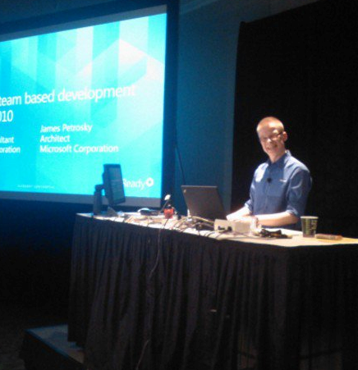

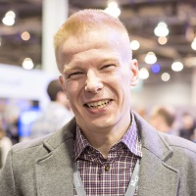





Vesa Juvonen
Pre-Microsoft
Entrepreneur, ICL, Fujitsu, Basware
Software Architect, Project manager, program manager, Developer, Casino dealer and middle manager, substitute teacher in high school, Hamburger joint worker
Microsoft (2006-)
Senior Program Manager (2014-)
Principal Consultant (2006-2014)
WW CoE SharePoint – Ranger
SharePoint 2013 Ignite Program Manager
Instructor in SharePoint 2013 and 2010 Ignite programs
MCM/MCSM Instructor & Content Owner
Instruction cross 18 rotations from start to finish of the program
Contact
Yammer– aka.ms/OfficeDevPnPYammer
Blog – http://blogs.msdn.com/vesku
Twitter - @vesajuvonen
Expertise
It’s Finglish…
Passion for the cloud

Slide 6
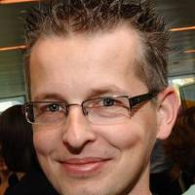






Bert Jansen
Pre-Microsoft
RealDolmen
Software architect, product manager, developer
Microsoft (2007-)
Senior Consultant
SharePoint deliveries to on-premises and cloud
Lead architect for the infrastructure, development and governance aspects of the implementation
Contact
Yammer– aka.ms/OfficeDevPnPYammer
Expertise
Cloud based deliveries
Value for your investments

Slide 7
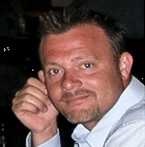

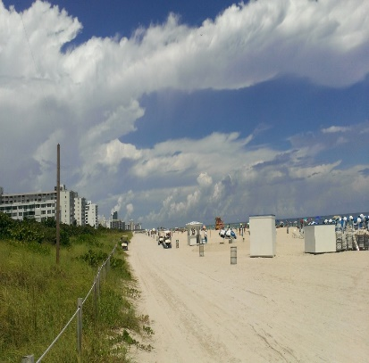
Frank Marasco
Pre-Microsoft
Java/C/C++, C#
SharePoint
WebSphere
Healthcare Professional
Microsoft (2005)
Field Guy in Microsoft Services
America Cloud Services
Contact
Yammer– aka.ms/OfficeDevPnPYammer
Blog – http://blogs.msdn.com/b/frank_marasco/
Twitter - @frank_marasco
Expertise
Cloud based deliveries
The cleaner…

Slide 8
Brian Michely
Pre-Microsoft
Voice recognition software development, BizTalk Server, Logistics .com startup development lead
Microsoft (2001-Present)
Principal Consultant
MCS Guy, Cloud Guy
Contact
Yammer– aka.ms/OfficeDevPnPYammer
Cloud based deliveries
Expertise
Passion for the cloud

Slide 9



Suman “Shoe” Chakrabarti
Pre-Microsoft
PPG, Bennett Adelson, CEI
.NET, Web Design/Dev, UX, WinPhone
Photography/Graphic Design
Microsoft (2006-present)
Sr. Consultant
MCS Guy, Cloud Guy
Contact
Yammer– aka.ms/OfficeDevPnPYammer
Blog – http://blogs.msdn.com/sumanc
Twitter - @sumanch
Expertise
Cloud based deliveries
Passion for the cloud

Slide 10
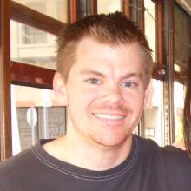


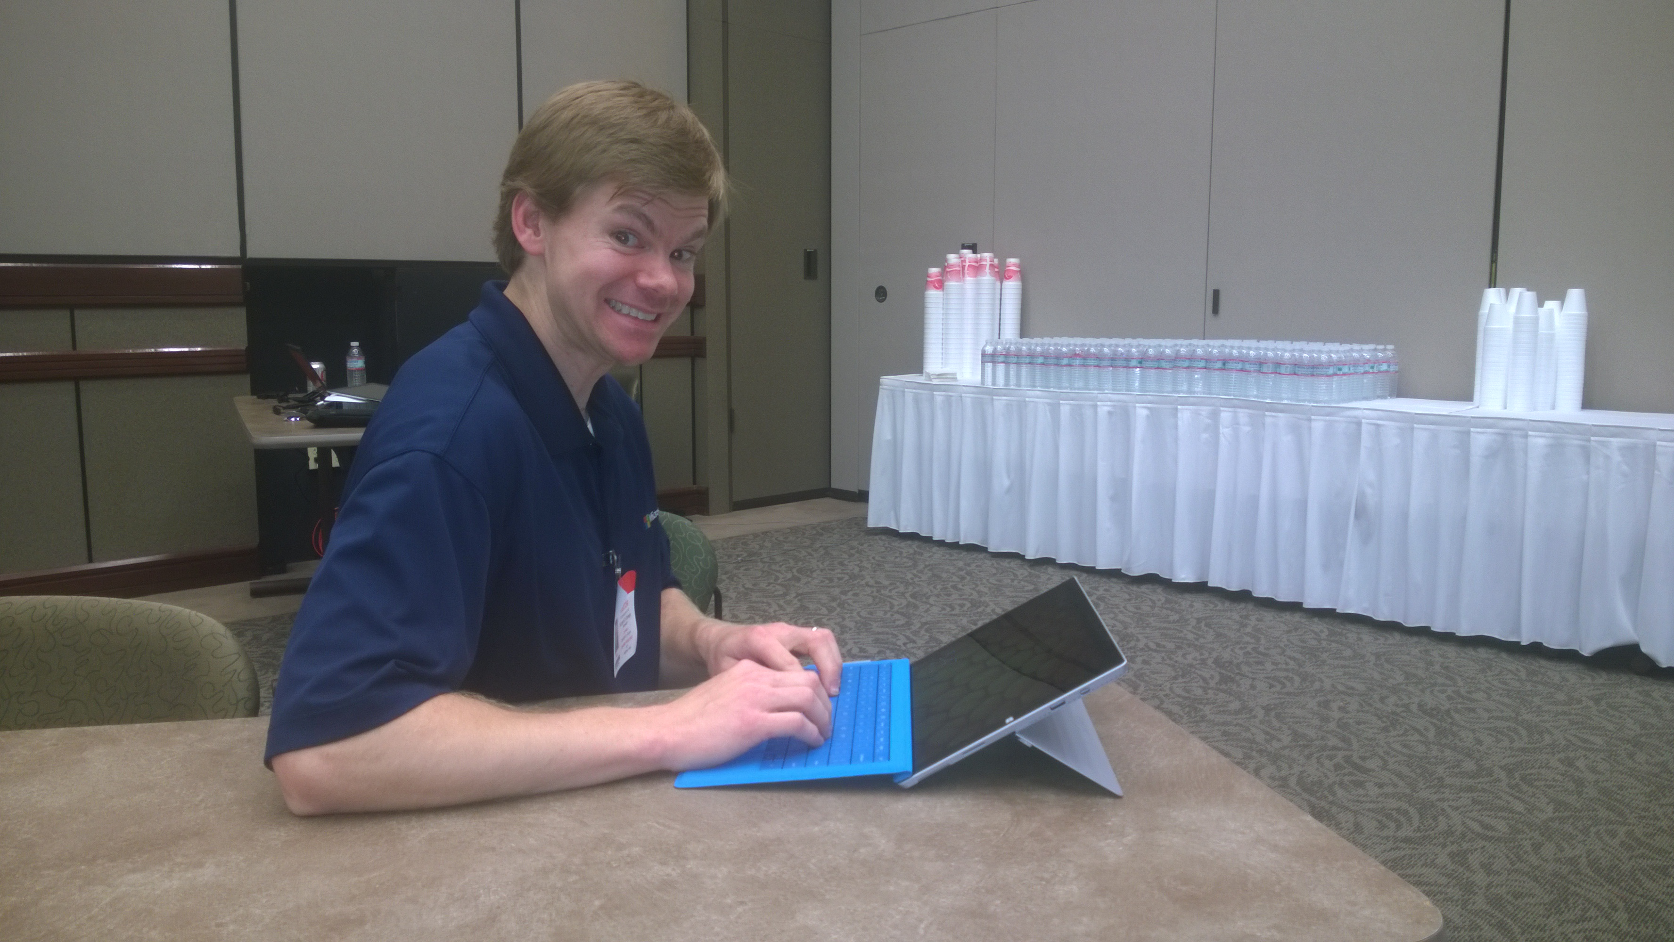


Richard diZerega
Pre-Microsoft
10 years Consulting at Microsoft Partner
Developer, Business Intelligence, SharePoint
Microsoft (2011-present)
Microsoft Technology Center Dallas
PnP Contributor, Speaker, App Builder
Ignite/Office 365 Summit Instructor
Contact
Yammer– aka.ms/OfficeDevPnPYammer
Blog – http://www.richdizz.com
Twitter - @richdizz
Office 365 as a Platform
Advocate of Apps and the Cloud
Donut Lover

Slide 11

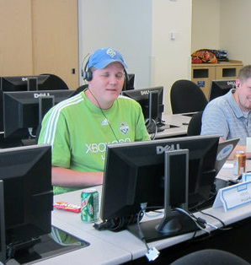
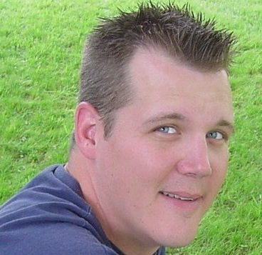


Steve Walker
Pre-Microsoft
Twisting and bending SharePoint in ways that I may or may not should have done. Learned a LOT about what works and what doesn’t end well.
Microsoft (2007-2011)
Microsoft Consulting Services
Microsoft (2011-2014)
SharePoint Customer Advisory Team O365 Customer Advisory Team - APPS
Contact
Yammer– aka.ms/OfficeDevPnPYammer
Twitter - @SharePointing
Expertise
Lot of talking and hand waving…
Doing the heavy lifting…

Slide 12
Statistics– Key numbers
Forked 58 times
More than Office 365 Android SDK or OpenXML SDK
Most popular repository under the OfficeDev organization
More than 1700 unique visitors during last 2 weeks
Yammer group has 416 members
aka.ms/OfficeDevPnPYammer

Slide 13

Key contributors this month
Thank you for your assistance!
Erwin Van Hunen (Knowit AB) - @knowsharepoint
Patrik Björklund (Alloc IT) - @pbjorklund
Sly Gryphon (Readify) - sgryphon
Vardhaman Deshpande (Content and Code) - vrdmn
Andrew Connell - @andrewconnell
Todd Baginski (Canviz LLC) - @toddbaginski
Wictor Wilén - @wictor

Slide 14
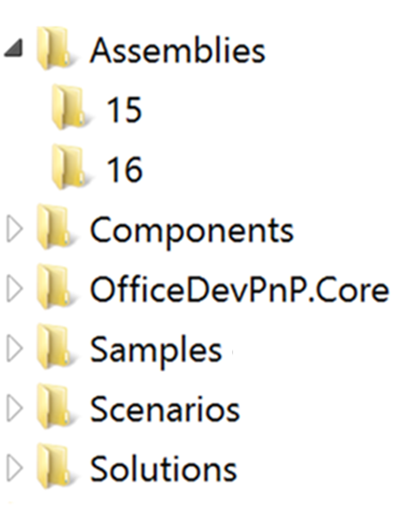
PnP Structure – folders and code
All referenced assemblies are included in package.
Contains latest 15 & 16 versions of the CSOM components.
No need for additional downloads
Reusable components targeted for reuse as such in projects.
Reusable remote operation component with extensions methods to standard CSOM objects.
Sample projects. Independent samples demonstrating a capability or functionality.
Scenario demonstrations for the usage of the core component. Contains additional explanations and usage models for API patterns.
Complex reusable solutions demonstrating combining multiple capabilities for building real solution. Uses core component.

Slide 15
Master merge
We are planning to perform master merge on during this week to sync up things
More detailed testing will be done before this one
In general we are moving to monthly master branch releases from this moment forward

Slide 16
How to contribute?
We just released documentation on this
https://github.com/OfficeDev/PnP/wiki/contributing-to-Office-365-developer-patterns-and-practices
Simple steps
Fork
Apply changes and contributions
Submit a pull request
Core team members will review
Merged to Dev

Slide 17
Nuget for Core component?
Common request already now
We are planning to do this already even before v1.0 release…
Thoughts?

Slide 18
Continuous integration plans
We are working on VS online for continuous integration
Currently only visible for internal people, but is evolving story

Slide 19
Latest changes and key add-on’s
Core
Significant updates on the core component
Unit testing for the core component
PowerShell commands
Erwin has done tremendous job with this one
Samples
JSON inject
Documentation
Preliminary set of slides related on the app model

Slide 20

Roadmap – What’s coming?
New patterns for SP side
More complex solution scenarios
Office client and JSOM patterns
Improvements to core component
Unit testing, logging, other stuff
Guidance
Application Life Cycle for app model
Design patterns for App model based implementation
Transformation guidance for existing customizations
App model impact for enterprise architecture
Content migration for app model implementation

Slide 21
POLL
Priority setting for the planned topics
Notes:
Priority on planned topics
More code samples
Add core component capabilities
Reusable presentation material
Documentation on patterns and practices for app model (ALM ec.)
More complex solutions
More Office Client apps
More JavaScript app
Length: 30 second for this slide
Instructor notes
The following slides will walk you though the Lync tools that we will use in this class.
You will use all of these tools later in the class
Stress that your students will be able to run much more engaging meetings if they use these tools in their own Lync Meetings.
Course Development Notes:

Slide 22
Transform your code Providing App Model Patterns for common Full Trust Code scenarios
50+ Visual Studio projects Common scenarios
Branding
Site provisioning
Remote event receivers
Large file support
Taxonomy driven navigation
And much more…
Contribute
This is open source project and open for contirbutions
Developer
Patterns & Practices
aka.ms/OfficeDevPnP

Slide 23

Questions?

Slide 24


© 2014 Microsoft Corporation. All rights reserved. Microsoft, Windows, and other product names are or may be registered trademarks and/or trademarks in the U.S. and/or other countries.
The information herein is for informational purposes only and represents the current view of Microsoft Corporation as of the date of this presentation. Because Microsoft must respond to changing market conditions, it should not be interpreted to be a commitment on the part of Microsoft, and Microsoft cannot guarantee the accuracy of any information provided after the date of this presentation. MICROSOFT MAKES NO WARRANTIES, EXPRESS, IMPLIED OR STATUTORY, AS TO THE INFORMATION IN THIS PRESENTATION.

